Slide 1
Software Product Management Rapid solutioning – Sprint technique
Nandagopal Govindan

Slide 2
Contents
Map the problem
Sketch the solution
Choose the best solution
Storyboard
Prototype
Test

Slide 3
Introduction
Quick solutioning & testing its effectiveness is important
Sprint is technique developed by Jake Knapp who used this technique in Google
He found ‘Sprint’ more effective than brainstorming to find solutions to problems, irrespective of the product – software, robot, healthcare
In brainstorming, he observed that much time was spent in discussing pros & cons of each solution. Also he found that resulting solutions were not always the best (Why?)

Slide 4
Idea in brief…
Map the problem: Draw a high level process map (swim lane), identify the key challenges to be addressed in the process
Sketch the solution: Create rough solutions – one per team member
Choose the best solution: Identify stand-out ideas in each solution, by voting
Storyboard: Create a storyboard by putting together the standout ideas
Prototype: Create a prototype – PPT, video, mockup, wireframe, etc.
Test: Show to potential users and get feedback

Slide 5
Steps in detail…

Slide 6
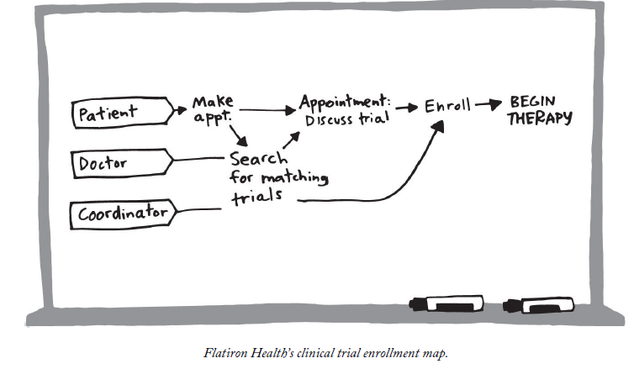
Map the problem
Process for enrolling patients for drug trials

Slide 7
Flatiron
Flatiron is a heath care company that analyses medical records and test data of cancer patients and help doctors to choose the right treatment.
Objective: Increase enrolment in clinical trials for new drugs (medicines)
Problem: Only 4% of cancer patients enrol for clinical trials. Increased enrolment would increase the collection of data about cancer treatment data which can be used by doctors to better treat future patients
There are different types of trials: Trials for drugs for common types of cancer, trials for drugs for rare forms of cancer. The types of trails are very many and it is hard to track humanly.
To determine which trial a patient should undergo (match), the doctors have to go through a lot of data such as treatment history, blood count, DNA mutations in cancer cell, and much more.

Slide 8
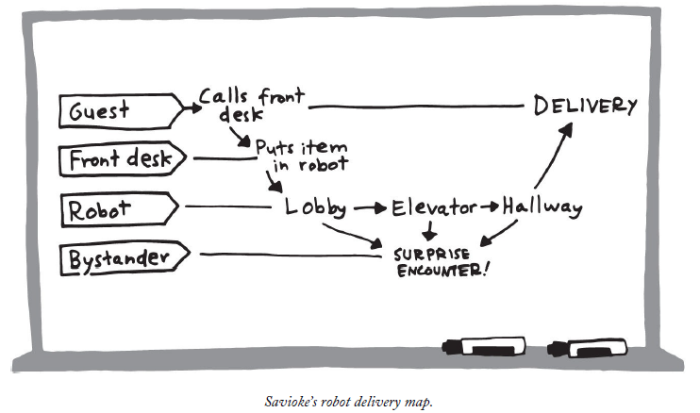
Map for Robot server in hotel
Picture of robot

Slide 9
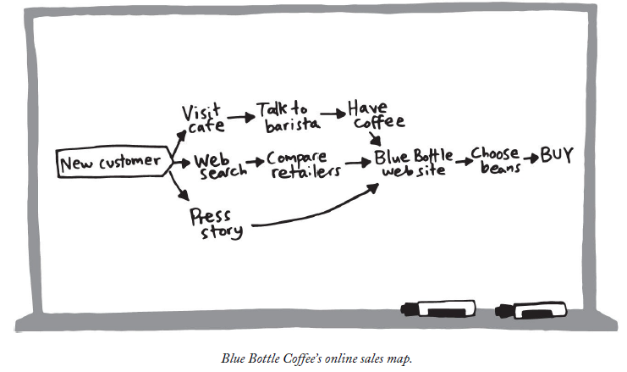
Map: Online coffee sales

Slide 10
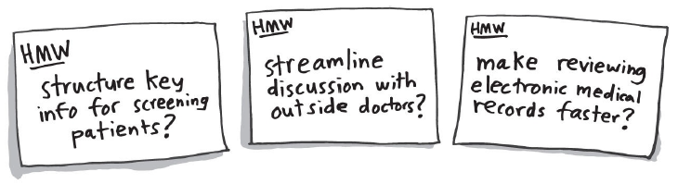
Map: Identify the key challenges to be addressed
HMW: How may we?

Slide 11
Map: Identify the key challenges to be addressed
How may we make it easy for customers to re-order?

Slide 12
Exercise
AirBnB: How may we questions:
What are the key challenges AirBnB needs to answer for their offering – stay in a house instead of staying in hotel?
How may we make it super easy to book a place to stay?
How may we create trust between two complete strangers?

Slide 13
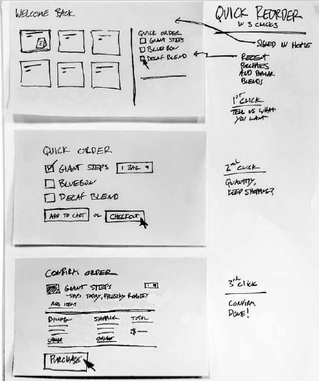
Sketch the solution
How may we make it easy for customers to re-order?
Step 1
Step 2
Step 3

Slide 14
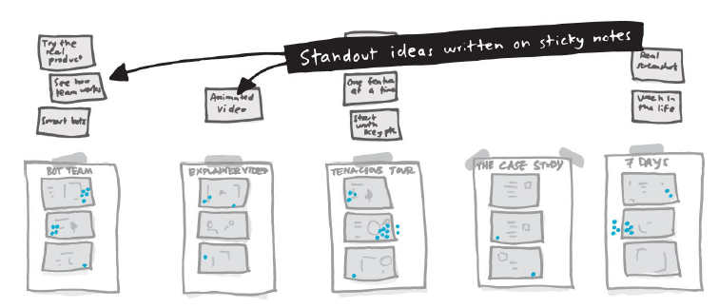
Identify standout ideas by voting

Slide 15
Create Story board
Pick the best solution based on votes. Product manager gets extra voting rights
If there are some stand out ideas in another solution, try to integrate the idea into the best solution
Put together story board of the final solution

Slide 16
Create a prototype
Divide prototyping work among team members
Prototype can be a video, mockup, wireframe, etc.
Build the prototype: Assemble the parts

Slide 17
Test the prototype to get customer feedback
Studies have shown that 5 users are enough to get 80-90% feedback
Understand customer background
Introduce prototype
Let customer use the prototype while someone takes notes
Quick debrief: Good aspects, aspects toimprove

Slide 18
Test: In detail…
Studies have shown that 5 users are enough to get 80-90% feedback
Welcome
Thank for coming
We are trying to improve our product,…
I will be asking a lot of questions as you use the product but I am not testing you, I am testing the product
If you get stuck or confused, it is not your fault. It helps us find problems.
I will start by asking some background questions, then I will show you somethings we are working on
Understand customer background
What kind of work do you do?
How long have you been doing that?
What do you do when you are not working?
Have you used any products to ….? What did you want them to do for you? What do you like or dislike about them?
Introduce prototype
Would you be willing to look at some prototypes?
Some things may not work quite right yet – if you run into something that is not working, I will let you know
Remind the customer, you are not testing the customer
Encourage the customer to think aloud as she uses the product – say what she is trying to do, how she plans to do, share what she likes, what she is confused about, etc.
Let customer use the prototype while someone takes notes
Ask questions to understand what the customer thinking or getting stuck about
Quick debrief
What did you like about the product, what did you dislike?

Slide 19
Case study: Slack
Slack messaging software had become hugely successful in tech companies. 500,000 users were using it for one-on-one messaging, chat room messaging,.. It had changed the way teams communicate. It had integrations with lots of other application and had become a hub.
Now Slack wanted to expand to non-tech companies. The marketing had not made much impact. So they got together to use Sprint approach to answer the questions – what is the best way to explain what Slack can do for you?
The team came up with 2 competing ideas – tenacious tour and Bot. They developed a prototype for each. One was a step by step explanation of Slack usage. Another was a mock up of a Bot – messages typed by the user will be answered by a Slack employee at the other end mocking a Bot.
The team showed these prototypes to 2 sets of users. The tenacious tour got better feedback though with some room for improvement. Thus they avoided the effort of developing the Bot which would have been quite expensive.

Slide 20
Exercise
Product: Digital music player device for senior citizens
What are the key questions / challenges?
Sketch a solution / UI for downloading a song and storing it in the device

Slide 21

Exercise: Digital music player device for senior citizens
Map (Swim lane)
Son / Daughter
Buy device
Subscribe to a plan
Senior citizen
Download songs
Play songs
What are the key questions / challenges? Let us now prioritize the challenges
https://docs.google.com/document/d/1PX7yRRSwWluzKA5pFy7kc3P861kdWhOQl8DBW8Nu0ew/edit?usp=sharing
Sketch a UI solution for downloading a song. Let us vote for the best solution.

Slide 22
Example of HMW questions
HMW questions: How may we make it easy for senior citizen to
Search & download a song or a set of songs, for example all songs from the Hindi film “Anand”?
Search & play a downloaded song?

Slide 23
Exercise…
Sketch a UI solution to search for & download a song
Then copy paste your UI solution in the same document
https://docs.google.com/document/d/1PX7yRRSwWluzKA5pFy7kc3P861kdWhOQl8DBW8Nu0ew/edit?usp=sharing
Then let us vote for the best solution.

Slide 24
Key learnings
What are the key learnings from this “Sprint” technique?

Slide 25
Appendix

